Slide 1
Business Presentation FOOD HUB

Slide 2
Contents
Food hub is Online food delivery service based in New York
It offers access to multiple restaurants through a single smartphone app.
The app assigns a delivery person from the company to pick up the order after it is confirmed by the restaurant.
The delivery person picks up the order and deliver to the customer, The customer can rate the order in the app based on their experience.
Objective
To extract the data to get a fair idea about the demand of different restaurants which will help business to enhance the customer experience.

Slide 3
Business Problem Overview and Solution Approach
Core business idea - Online food delivery service is a great option for students and busy professionals because of their hectic lifestyles.
Problem to tackle – People are more busy during weekdays and hence company must focus to improve the delivery time of the order.

Slide 4
Data Overview
The data contains customer details of the food aggregator company (Food Hub)
Variable | Description
order_id | Unique ID of the order
customer_id | ID of the customer who ordered the food
restaurant_name | Name of the restaurant
cuisine_type | Cuisine ordered by the customer
cost_of_the_order | cost
day_of_the_week | Indicates whether the order is placed on a weekday or weekend
rating | Rating given by the customer out of 5
food_preparation_time | Time taken by the restaurant to prepare the food (in minutes)
delivery_time | Time taken by the delivery person to deliver the food package (in minutes)
Observations | Variables
1898 | 9
Note:
The columns 'restaurant_name', 'cuisine_type', 'day_of_the_week’ , ‘rating’ are object types which is converted into category and float data type.
There are few missing values in the column ‘rating’.

Slide 5
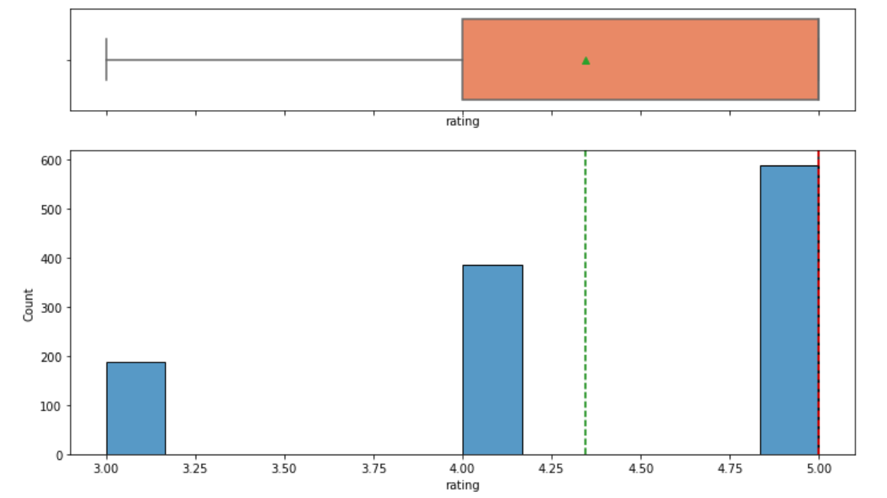
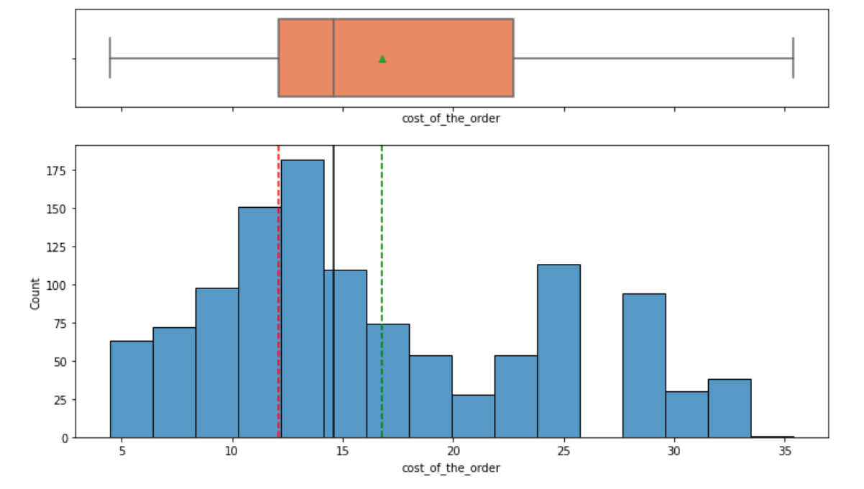
Exploratory Data Analysis (EDA) - Univariate Analysis
Rating
Cost of the order
OBSERVATIONS:
The distribution of rating is negative skewed(left skewed).
The mean value here is 4.34, here (mean < median < mode) and hence mean faces the negative end of the tail.
There are a no outliers in this variable and the whiskers extend to the min value.
Median and mode are same value.
The observations of rating starts from 3
OBSERVATIONS:
The distribution of cost_of_the_order is positive skewed(right skewed) and has a heavy right tail.
The mean value here is 16.49
There are a no outliers in this variable.
The observations of cost_of_the_order starts from 4.47 to 35.41

Slide 6
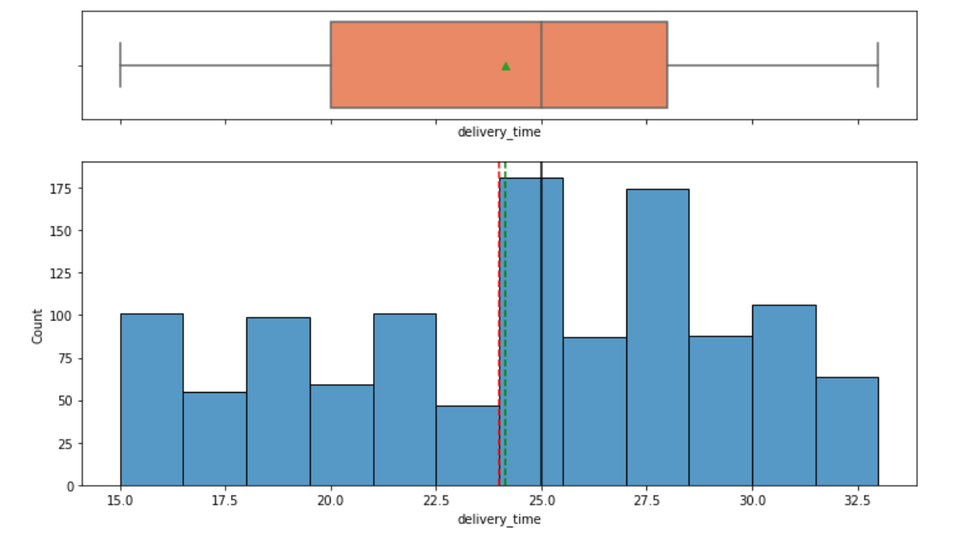
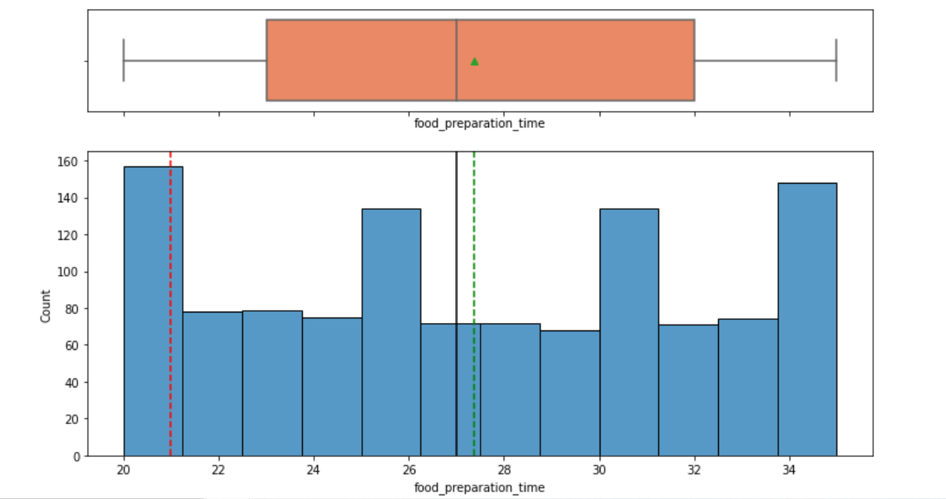
Exploratory Data Analysis (EDA) - Univariate Analysis
Delivery time
Food preparation time
OBSERVATIONS:
The mean value here is 27.37 and median value is 27 (there is no difference between mean and median)
There are a no outliers in this variable.
Most number of food preparation time is done in 21 minutes(based on the mode value) and it ranges between 20 minutes to 35 minutes.
OBSERVATIONS:
The distribution of delivery_time is left skewed(negative skewed).
There are a no outliers in this variable.
Most number of deliveries is done in 24 minutes.

Slide 7
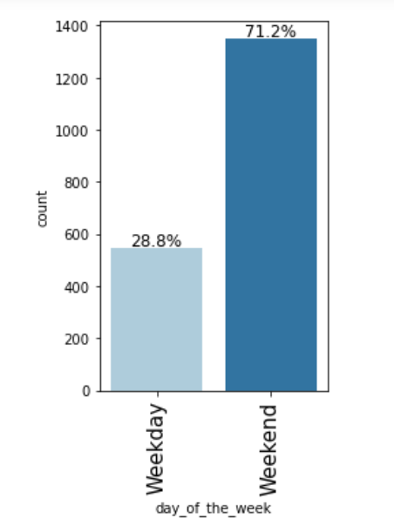
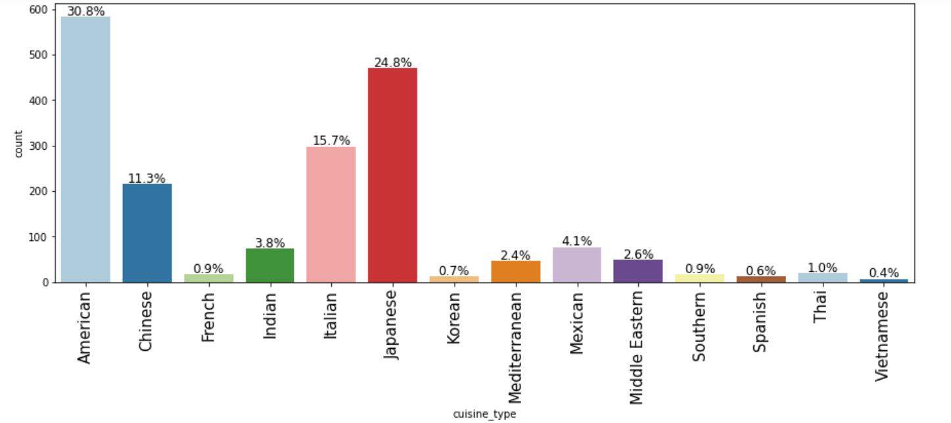
Exploratory Data Analysis (EDA) - Univariate Analysis
From the above depiction we see that,
The top 3 cuisine orders are: American - 30.8%, Japanese - 24.8% and Italian - 15.7%.
Maximum orders are placed during Weekends.

Slide 8
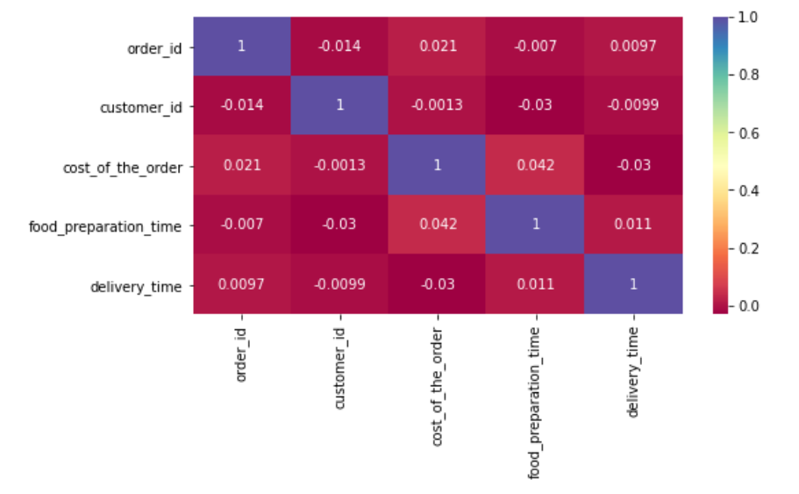
Correlation of data
Observations:
Delivery time & cost of order is negatively correlated. If the delivery time is exceeded then rating from the customer is low
There is strong relationship between food preparation time and delivery time

Slide 9
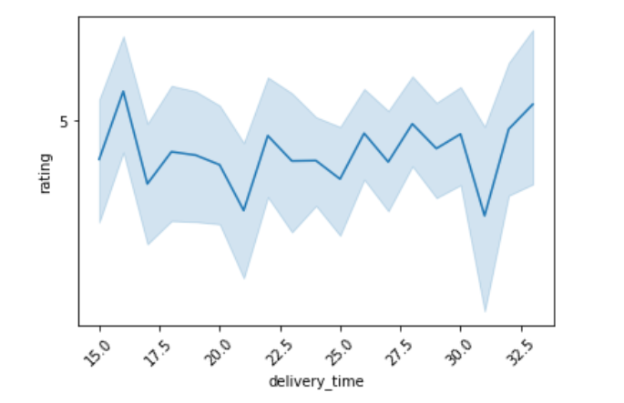
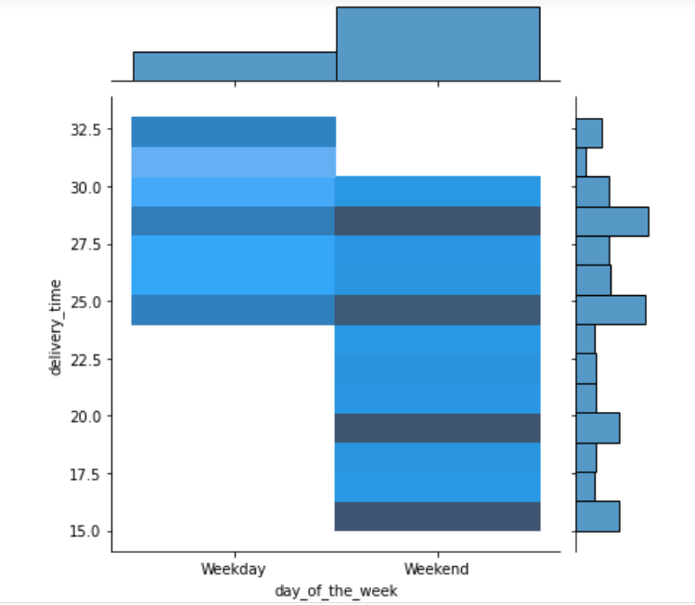
Exploratory Data Analysis (EDA) - Bivariate Analysis
From the above depiction we can see that,
As Delivery time is high, ratings from the customers are low.
During weekdays the delivery time taken to deliver the food is high compared to weekends.

Slide 10
Business Insights (Conclusion)
From the observation, we can conclude the following:
1. Overall rating for the restaurants starts from 3 and goes until 5.
2. Many customers are ordering food during weekends and the ratings are high during weekends compared to weekdays.
3. Most of the customers prefer to order American cuisine among other cuisine types.
4. Maximum number of orders are placed in these restaurants which are top 5 restaurants with maximum ratings, and they are:
* Shake Shack
* The Meatball Shop
* Blue Ribbon Sushi
* Blue Ribbon Fried Chicken
* Parm
5. In the top 5 restaurants given , many customers prefer to order American,Japanese & Italian.
6. The bottom 5 preferred cuisine types are Vietnamese, Spanish ,Thai, Korean and French.

Slide 11
Recommendations
1. Weekend orders are high and by this analysis we need to ensure that there are more delivery person available to deliver the orders even more quicker, by this we can get more rating from the customers
2. The bottom 5 preferred cuisines can be ruled out from the app if not performing well, or gather more data in terms of cost vs profit to take further decisions.
3. The top 5 restaurants which are performing well can give more discount to attract more customers
4. Though the number of orders are less during weekdays more time is taken to deliver the food when compared with weekends and hence over here analysis must be done.

